Slide 1
Application Server
An application server is a component-based product that resides in the middle-tier of a server centric architecture. It provides middleware services for security and state maintenance, along with data access and persistence.
When to Use an Application Server:
You should consider an application server when you have a need for:
Integration with existing systems and databases
Website support
Secondary reasons to use application servers derive from the primary reasons. A few secondary reasons are:
E-Commerce
Web-integrated collaboration
Component re-use
One way to look at application servers is that they are a formalization of a solution to a problem that has been around for a long time. That problem can characterized as a need to create an integrated presentation and processing environment for existing systems and databases. The presentation has pretty much been decided with browsers now being the dominant interface. This is why you usually see a Web server paired with or included in an application server. The integrated processing has been moving towards components for some time. Application servers provide containers for such components along with application program interfaces (APIs) to support the components. These APIs are to the existing systems and databases.
http://www.service-architecture.com/articles/application-servers/index.html

Slide 2
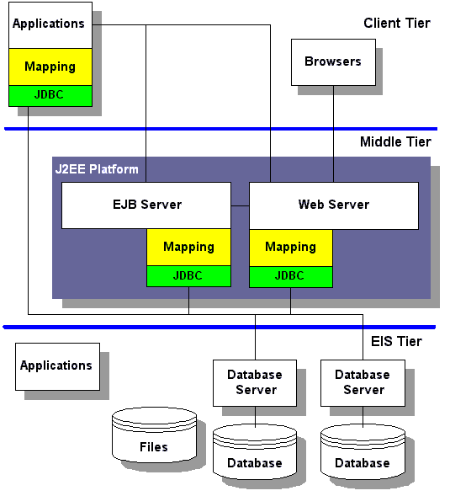
Application Server Architectures:
The J2EE platform requires a database for the storage of business data. This database is accessible through the JDBC, SQLJ, or JDO APIs. Also, the database is accessible from web components, enterprise beans, and application client components
http://www.service-architecture.com/articles/application-servers/application_server_architectures.html

Slide 3
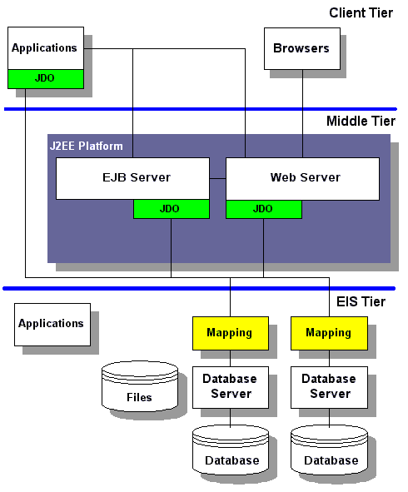
JDO with Application Servers:

Slide 4
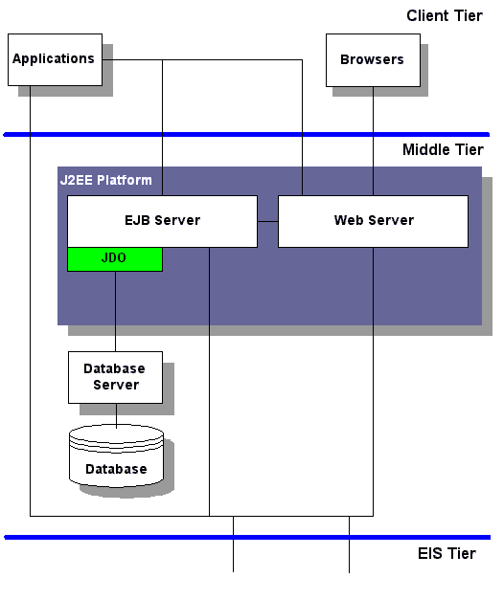
EJB Accelerators with Application Servers:
Their role is to accelerate the performance of storing data needed for Enterprise Java Beans (EJBs). By speeding up the performance of the data storage, the performance of EJBs are accelerated in general. There are four ways that this can be done.
(1) The first way is with a transparent interface such as Java Data Objects (JDO) coupled with an object database. In this case, there is no need for a mapping layer because the Java object model is the same model used by the object database.The lack of a mapping layer is show in this diagram.

Slide 5
The second way is with a transparent interface such as Java Data Objects (JDO) coupled with a relational database. In this case, there is a need for a mapping layer because the Java object model may not match the model used by the relational database. Nevertheless, the mapping can be moved to one location as described in JDO Data Conversion. Also see transparent persistence in object-relational mapping.
The third way is with a call-level interface such as JDBC coupled with a relational database. In this case, there is a need for a mapping layer because the Java object model may not match the model used by the relational database. The mapping would need to be done at the application level as described in JDBC Data Conversion. Be sure to take a look at transparent persistence vs. JDBC call-level interface. This outlines some disadvantages of using JDBC that you should consider when designing persistence for J2EE.
The fourth way is with SQLJ and a relational database. This would be useful primarily if the relational database does not contain any existing data. This would make it possible to minimize the mapping described in SQLJ Data Conversion. Also see SQLJ and mapping SQL and Java data types.

Slide 6
APPLICATION SERVER TYPES
BEA WebLogic Server
Oracle
Orion Server
WebSphere
NetDynamics
JRun Server
Tomcat
Pramati Server
Power Tier for J2EE
Glassfish
JBoss Enterprise Application Platform
Wildfly,Apache TomEE,JOnAS,Resin Servlet Container (Open Source) ,Blazix
http://www.roseindia.net/javabeans/applicationservers.shtml

Slide 7
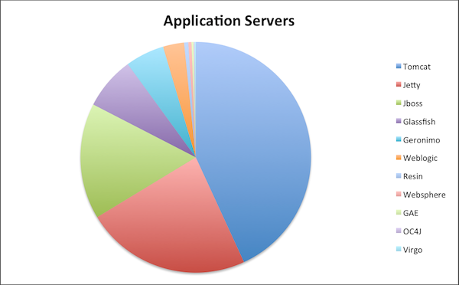
Most Popular App Servers:
https://plumbr.eu/blog/java/most-popular-application-servers

Slide 8
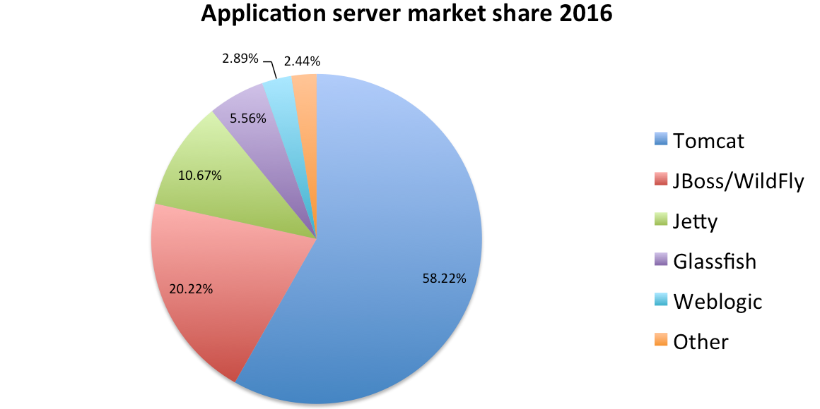
Java Application Servers In the Market
https://plumbr.eu/blog/java/most-popular-java-ee-servers-2016-edition

Slide 9
Web Server:
A Web server is a program that uses HTTP (Hypertext Transfer Protocol) to serve the files that form Web pages to users, in response to their requests, which are forwarded by their computers' HTTP clients. Dedicated computers and appliances may be referred to as Web servers as well
Types of Webservers:
Apache web server – the HTTP web server:
Free and the most popular web server in the world developed by the Apache Software Foundation. Apache web server is an open source software and can be installed and made to work on almost all operating systems including Linux, Unix, Windows, FreeBSD, Mac OS X and more. About 60% of the web server machines run the Apache web server
Microsoft’s Internet Information Services (IIS) Windows Server:
IIS Windows Web Server has been developed by the software giant, Microsoft. It offers higher levels of performance and security than its predecessors. It also comes with a good support from the company and is the second most popular server on the web.
http://www.webdevelopersnotes.com/web-servers-list

Slide 10
Nginx web server:
Free open source popular web server including IMAP/POP3 proxy server. Hosting about 7.5% of all domains worldwide, Nginx is known for its high performance, stability, simple configuration and low resource usage. This web server doesn’t use threads to handle requests rather a much more scalable event-driven architecture which uses small and predictable amounts of memory under load.
Lighttpd:
lighttpd, pronounced “lighty”, is a free web server distributed with the FreeBSD operating system. This open source web server is fast, secure and consumes much less CPU power. Lighttpd can also run on Windows, Mac OS X, Linux and Solaris operating systems.
Jigsaw:
Jigsaw (W3C’s Server) comes from the World Wide Web Consortium. It is open source and free and can run on various platforms like Linux, Unix, Windows, Mac OS X Free BSD etc.
Klone:
Klone, from KoanLogic Srl, includes a web server and an SDK for creating static and dynamic web sites. It is a web application development framework especially for embedded systems and appliances. No additional components are required when using Klone; thus, one can do away with an HTTP/S server or the active pages engine (PHP, Perl, ASP).
http://www.webdevelopersnotes.com/web-servers-list

Slide 11
Abyss web server:
Abyss compact web server runs on all popular platforms – Windows, Mac OS X, Linux and FreeBSD. The personal edition is (X1) 100% free while the professional Abyss Web Server X2 has a small price tag of $60. Supports HTTP/1.1, secure connections, CGI/ FastCGI, custom error pages, password protection and much more. The server also has an automatic antihacking system and a multiligual remote web management interface.
Oracle Web Tier:
Includes two web server options with reverse proxy and caching solutions that lead to quick serving of web pages and easy handling of even the most demanding http traffic. The iPlanet Web Server, for example, is a high-performance server with enhanced security and multithreaded architecture that scales well on modern 64-bit multiprocessors.
Node.js
Node.js is a server-side JavaScript environment for network applications such as web servers. With a smaller market position, Node.js powers 0.2% of all websites. Node.js was originally written in 2009 by Ryan Dahl. The Node.js project, governed by the Node.js Foundation, is facilitated by the Linux Foundation's Collaborative Projects program.(https://opensource.com/business/16/8/top-5-open-source-web-servers)
http://www.webdevelopersnotes.com/web-servers-list

Slide 12
X5 (Xitami) web server:
X5 is the latest generation web server from iMatix Corporation. The Xitami product line stretches back to 1996. X5 is built using iMatix's current Base2 technology for multithreading applications. On multicore machines, it is much more scalable than Xitami/2.
Zeus web serve:
The Zeus web server runs on Linux and Free BSD operating systems among others. It has been developed by Zeus technology Ltd. And is known for its speed, reliability, security and flexibility. The web server is used on some of the busiest web sites of the world including eBay. Zeus web server is not free and costs more than a thousand pounds.
http://www.webdevelopersnotes.com/web-servers-list
LAMP (Apache + MySQL + PHP):
LAMP is the acronym for a free and open source software suite, usually used to define and run a dynamic web server infrastructure, software development and establish a software distribution package.Linux: the OS
Apache: the Web server
MySQL: the database management system
And finally one of these scripting languages: Perl, PHP or Python.(http://ccm.net/faq/1172-lamp-apache-mysql-php-quick-install-on-linux).

Slide 13
Cloud:
A place where you can access apps and services, and where your data can be stored securely. The cloud is a big deal for three reasons:
It doesn't need any effort on your part to maintain or manage it.
It's effectively infinite in size, so you don't need to worry about it running out of capacity.
You can access cloud-based applications and services from anywhere – all you need is a device with an Internet connection.

